Slide 1
Chemical Ideas 3.5
Geometric Isomerism
(different geometries)

Slide 2
Types of isomerism
Isomerism
Structural isomerism
Stereoisomerism
Geometric isomerism
Optical isomerism

Slide 3
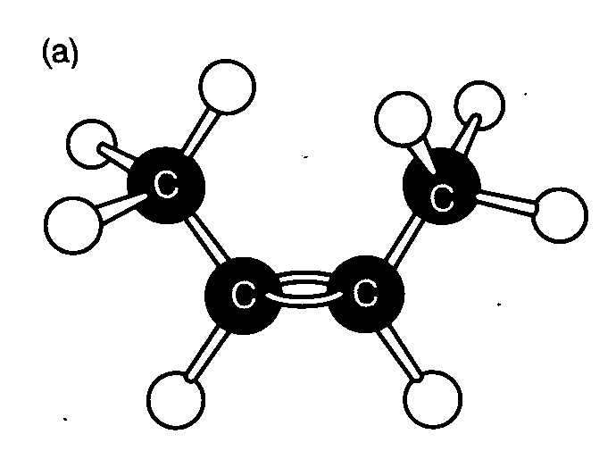
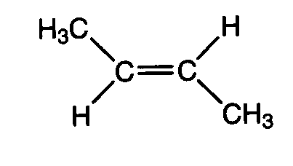
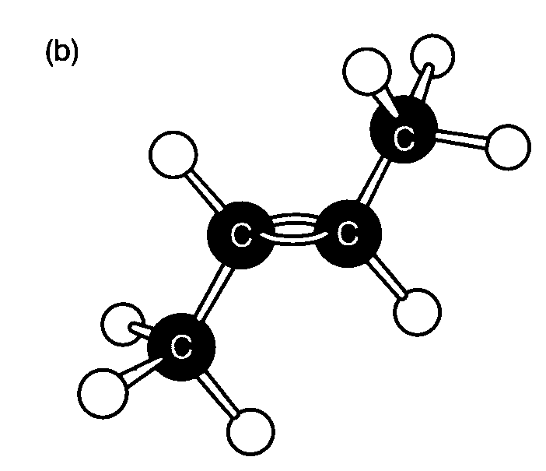
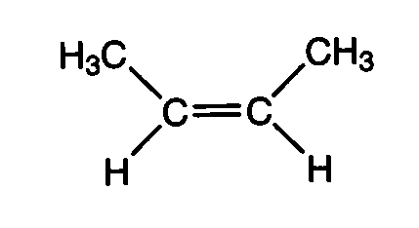
Build these models
trans but-2-ene
Cis but-2-ene

Slide 4
Two isomers are not interchangeable.
Carbon 2 & 3 joined by double bond.
No free rotation.
Bonds would have to be broken and reformed.
+270 kJ mol⁻¹ energy needed to break this bond.
Insufficient energy available at room temperature.

Slide 5
cis...
Different names needed to identify isomers.
Substituent groups on the same side of double bond.
Cis but-2-ene
Cis but-2-ene

Slide 6
...and trans.
“trans” means other side or cross over e.g. trans Atlantic, transplant, trans…..!
Substituents on opposite sides of double bond.
trans but-2-ene

Slide 7
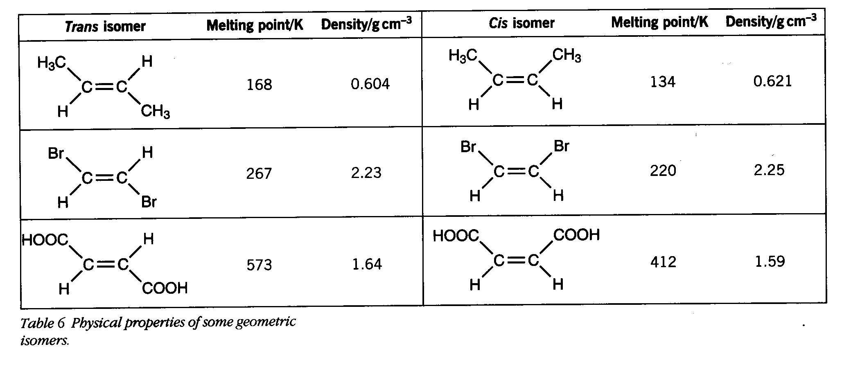
Different compounds- different properties.

Slide 8
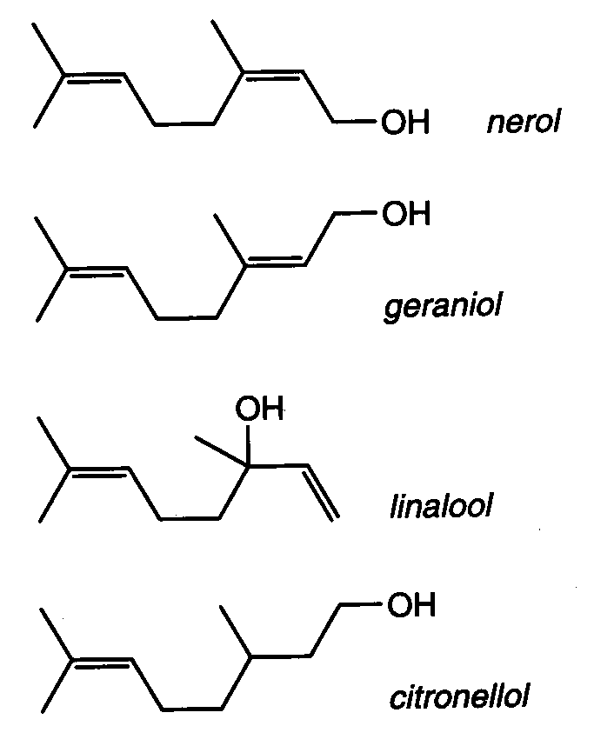
Time to think and apply what we have learned!
How are the structures of nerol and geraniol related?
How many moles of H₂ would be needed to saturate one mole of geraniol?
How are nerol and geraniol related to citronellol?
How are the structures of nerol and geraniol related to linalool?

Slide 9
This powerpoint was kindly donated to www.worldofteaching.com
http://www.worldofteaching.com is home to over a thousand powerpoints submitted by teachers. This is a completely free site and requires no registration. Please visit and I hope it will help in your teaching.

